Slide 1
PROJECT TITLE
STEGANOGRAPHY PROJECT
Presented By: SHRAVANI VIKAS KASAR
Student Name : SHRAVANI VIKAS KASAR
College Name & Department : BHAVAN’S COLLEGE ANDHERI WEST (COMPUTER SCIENCE DEPARTMENT)

Slide 2
OUTLINE
Problem Statement
Technology used
Wow factor
End users
Result
Conclusion
Git-hub Link
Future scope

Slide 3
Problem Statement
Steganography is the practice of concealing information within another message or physical object to avoid detection.
. Steganography can be used to hide virtually any type of digital content, including text, image, video, or audio content. That hidden data is then extracted at its destination.
. The purpose of steganography is to conceal and deceive.
.It is a form of covert communication and can involve the use of any medium to hide messages. It's not a form of cryptography, because it doesn't involve scrambling data or using a key.
.Instead, it is a form of data hiding and can be executed in clever ways.

Slide 4
Technology used
LIBRARIES USED:
import cv2-Used for image processing (loading, modifying, and saving images).
import os-Used for interacting with the operating system (opening files).
import tkinter as tk-Used for creating the graphical user interface (GUI).
PLATFORM USED :
PYTHON IDE-3

Slide 5
Wow factors
One of the unique aspects of this project is the incorporation of a graphical user interface (GUI). The use of a GUI enhances the overall user experience, making the project more intuitive, visually appealing, and user-friendly. This approach ensures that users can interact with the system more efficiently, making the application both accessible and engaging.

Slide 6
End users
Steganography can be used both for constructive and destructive purposes. For example, education and business institutions, intelligence agencies, the military, and certified ethical hackers use steganography to embed confidential messages and information in plain sight.

Slide 7

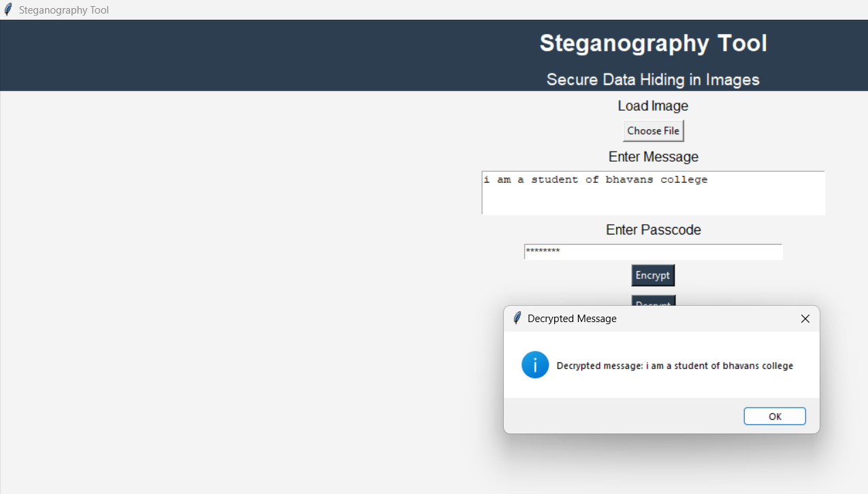
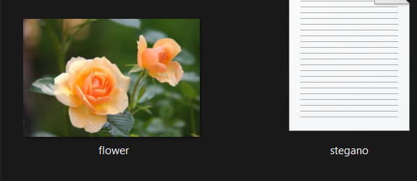
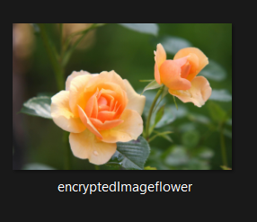
Results

Slide 8
Conclusion
In conclusion:
Steganography is the technique of hiding information within digital content, such as text, images, videos, or audio, to avoid detection. Unlike cryptography, it does not encrypt data but conceals it within another medium for covert communication. The hidden information is later extracted at its destination without raising suspicion. The main objective of steganography is secrecy and deception, making it a powerful tool for secure data transmission.

Slide 9
GitHub Link
https://github.com/Sana-world/Steganography-project.git

Slide 10
Future scope(optional)
Future Scope of Steganography
Enhanced Security in Digital Communication – As cyber threats continue to evolve, steganography can be integrated with cryptographic techniques to provide an extra layer of security for confidential data transmission.
Steganography in Artificial Intelligence – AI and machine learning can be leveraged to develop more advanced and undetectable steganographic techniques, improving data concealment and retrieval processes.
Application in Cybersecurity – Steganography can be used to secure sensitive information in military, intelligence agencies, and corporate environments, reducing the risk of cyber espionage and unauthorized access.
Steganography in IoT and Cloud Security – With the increasing adoption of IoT and cloud computing, steganography can play a vital role in securing data transmission between interconnected devices, ensuring privacy and integrity.

Slide 11
THANK YOU

